Slide 1
Earth Go Shake???
Predicting the location of earthquakes using depth, magnitude, and other factors
By: Aanchel

Slide 2
“The Depths Below”
Wanted to do something involving the planet, and ended up going for something ground-related
Earthquakes occur when the Earth’s crust releases energy, and the depth of an earthquake’s epicenter can impact how strong the earthquake is.
Using a Linear Regression Model, can we predict the latitude of an earthquake using features such as depth and magnitude?

Slide 3
The Dataset
USGS Data 1965 - 2016
Modifications
Date
Time
Horizontal Distance
Horizontal Error
Root Mean Square
ID
Source
Location Source
Magnitude Source
Status
Azimuthal Gap
Magnitude Error
Depth Error
Magnitude Seismic Stations
Use only the following categories
Latitude
Longitude
Depth
Depth Seismic Station
Magnitude
Magnitude Type
Clean up outliers using z-score and common sense*
One-hot-encode Magnitude Type
Balance data in Depth category

Slide 4
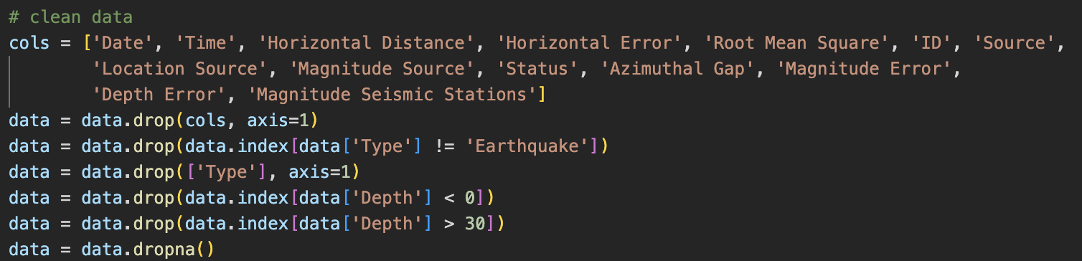
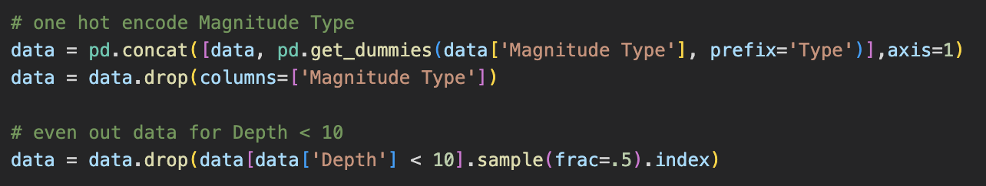
Cleaning the Data

Slide 5
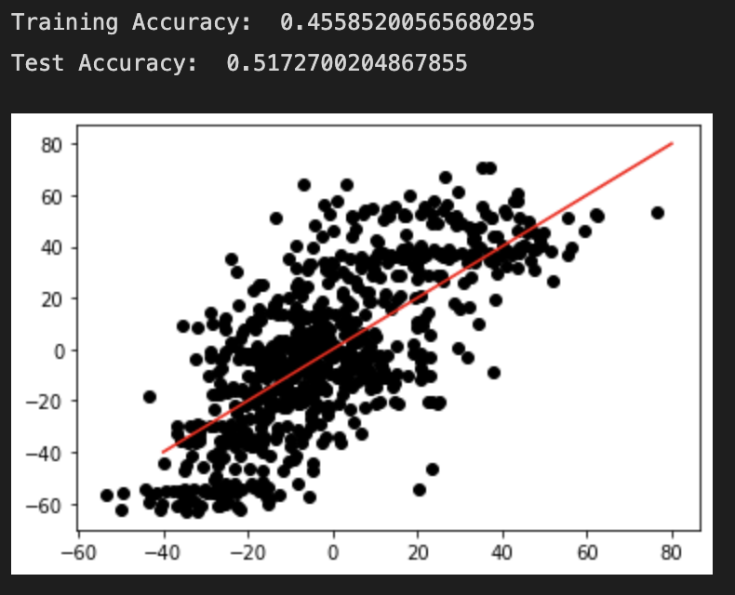
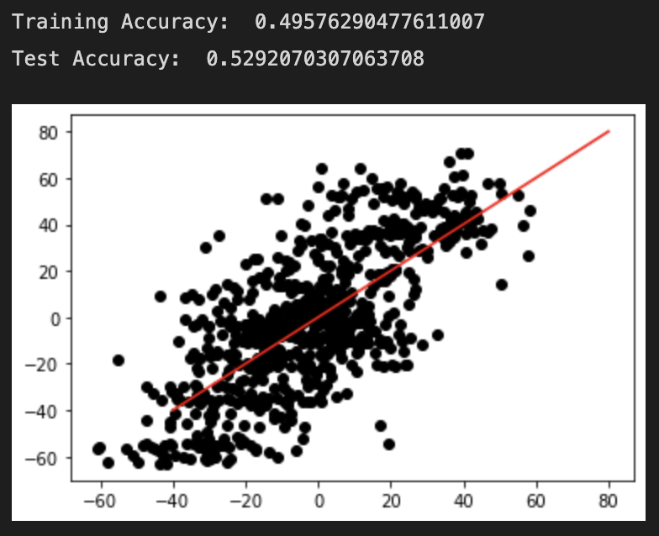
2nd Degree Polynomial Regression
Linear Regression

Slide 6
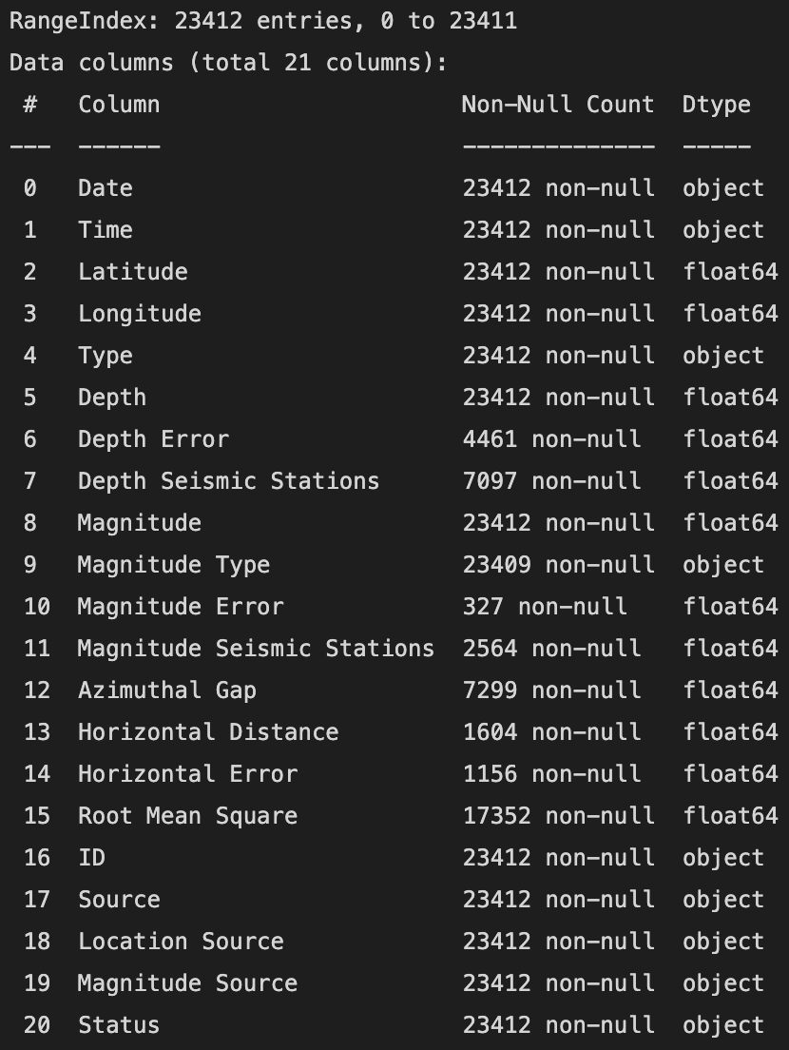
Issues
Improvements
Low accuracy
The dataset contained a lot of missing information
Find a new project
Find a better dataset
Newer and more location specific
Use multiple datasets
Build a more complex model

Slide 7
Thank You!
Questions?

